Slide 1
Statistics for ML

Slide 2
Hypothesis
NULL HYPOTHESIS
ALTERNATE HYPOTHESIS

Slide 3
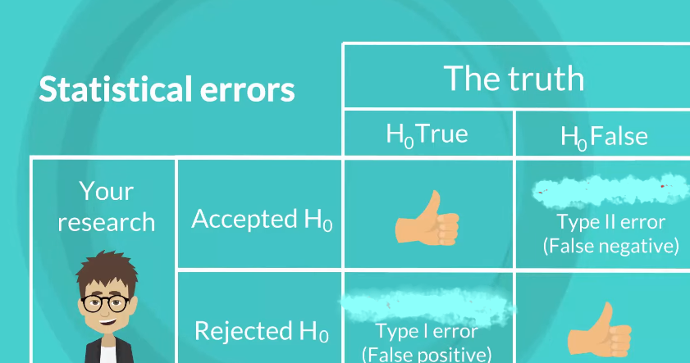

Slide 4
Test
If P<=0.05 Significance value, null hypothesis is proved wrong.

Slide 5
One categorical feature test → One sample proportion test
(With not more than 2 categories eg. Yes, No)
Two categorical feature test → Chi square test
One continuous variable → T-test
Two continuous variable → Correlation
One categorical, One continuous → T-test
(One categorical with not more than 2 categories eg. Yes,No)
Categorical feature , continuous → ANOVA
(with more than 2 categories)

Slide 6
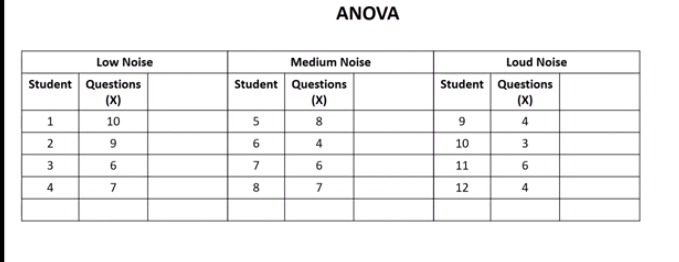
ANOVA

Slide 7
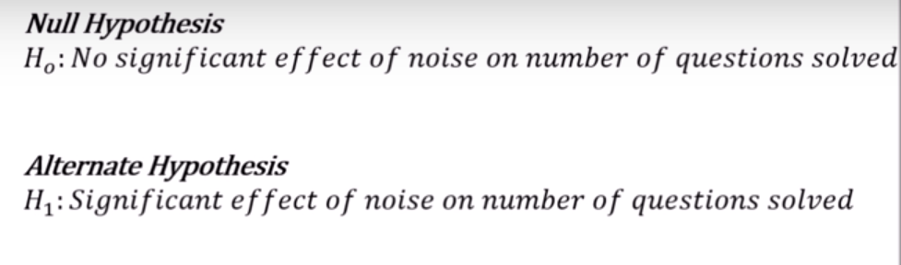

Slide 8
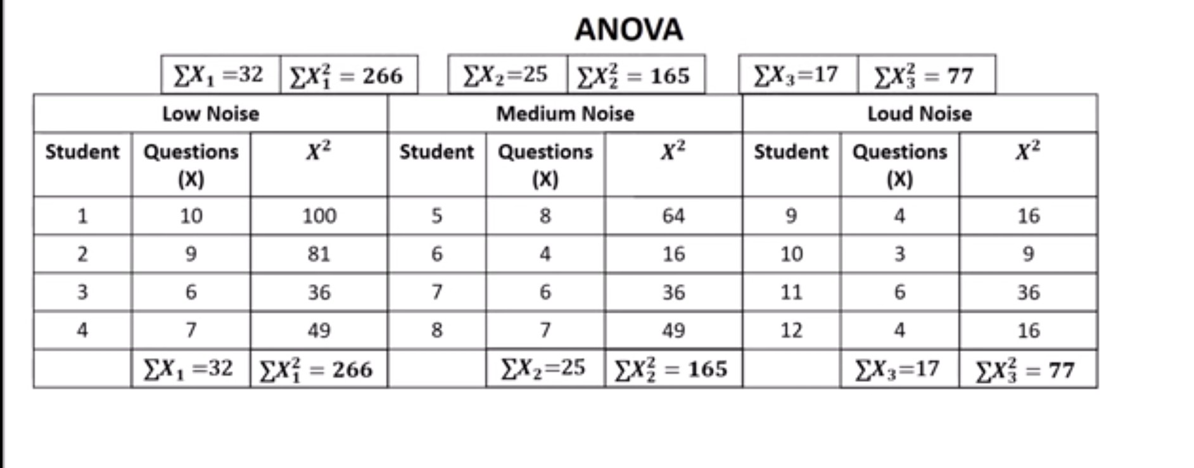

Slide 9
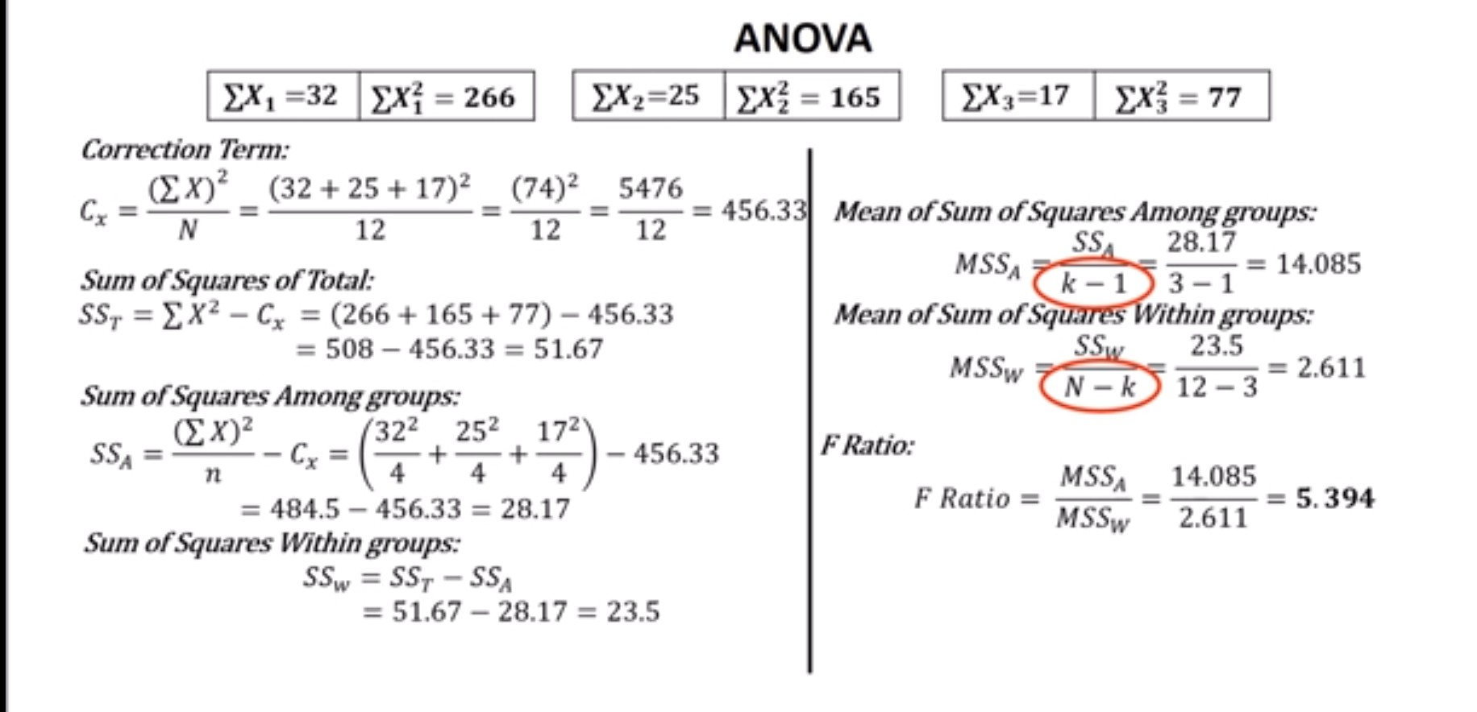

Slide 10
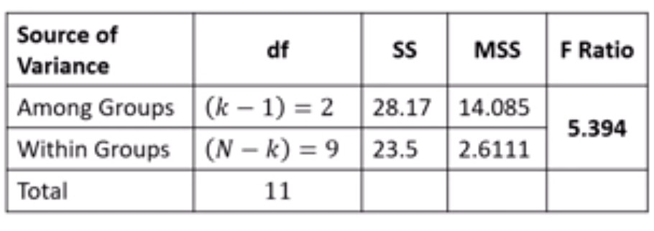

Slide 11
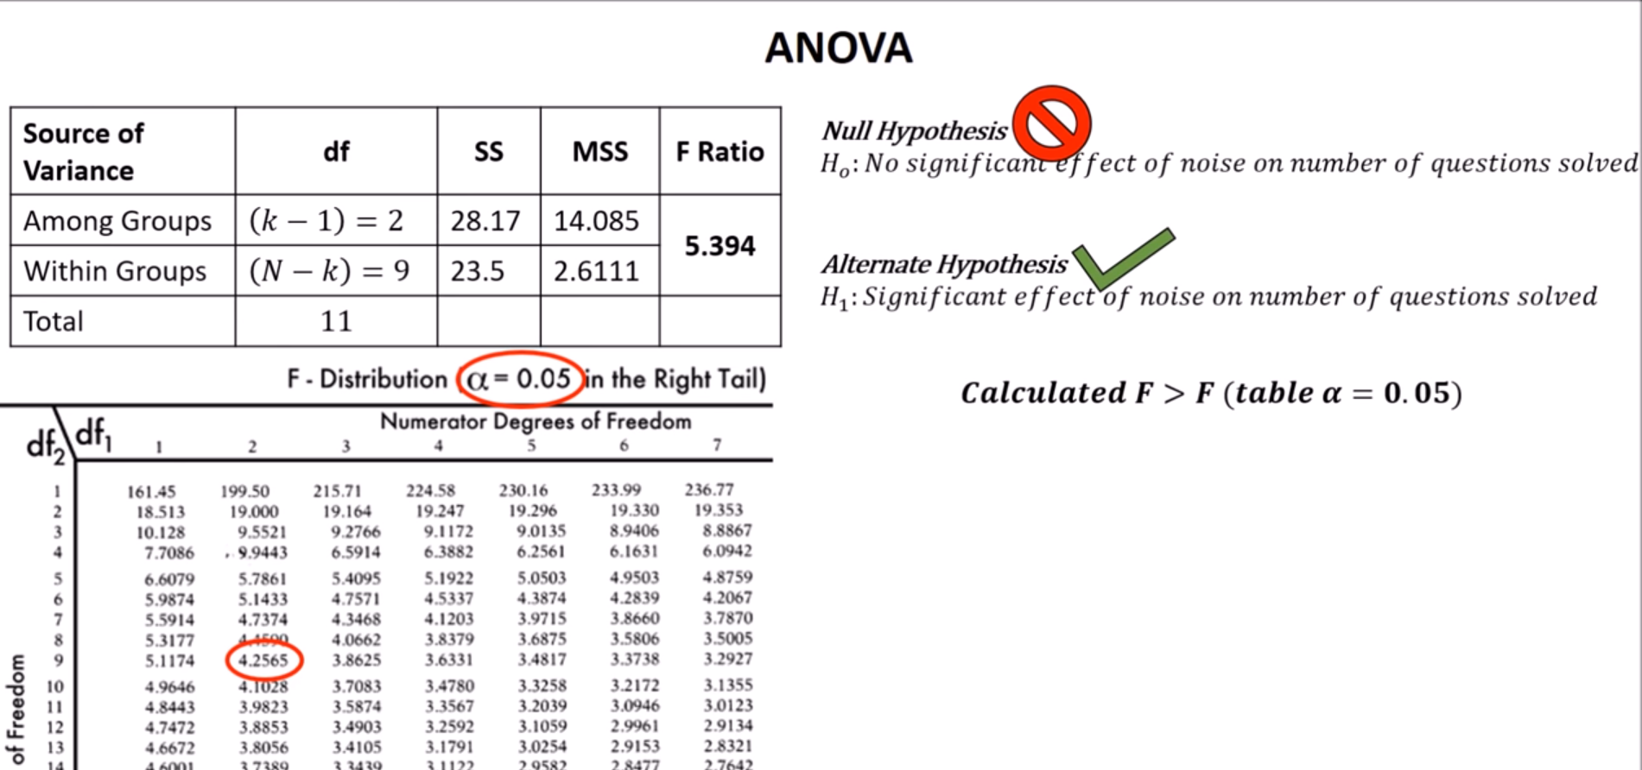

Slide 12
CHI SQUARE TEST
Chi square test is performed to Compare relation between categorical variables

Slide 13
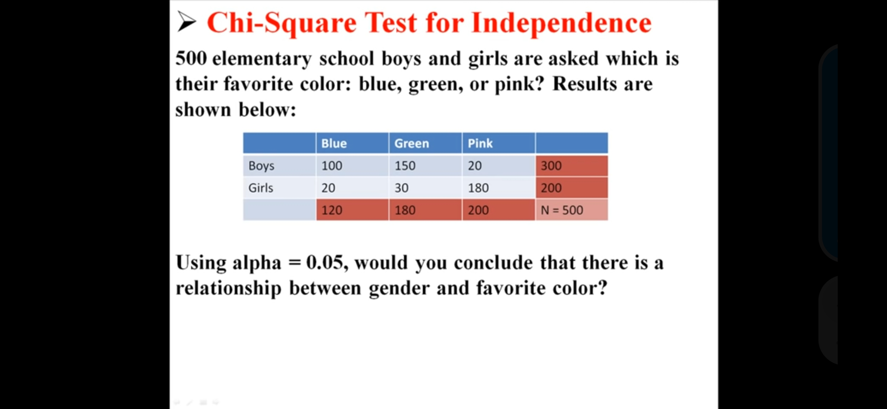

Slide 14
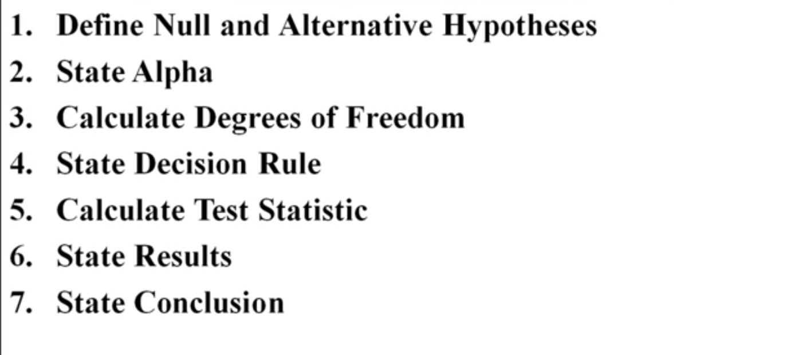

Slide 15
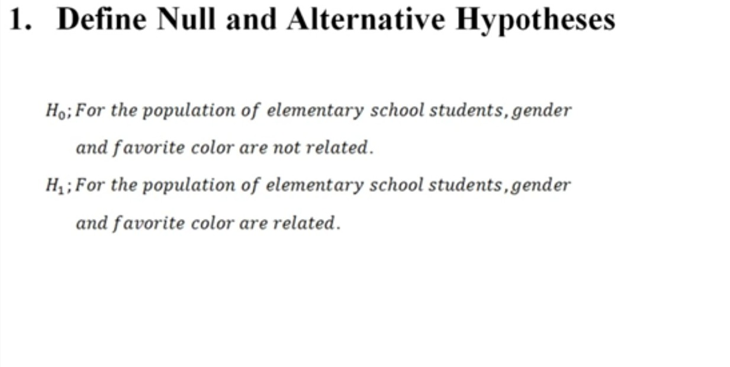

Slide 16
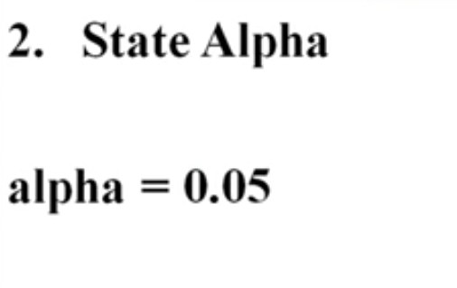

Slide 17
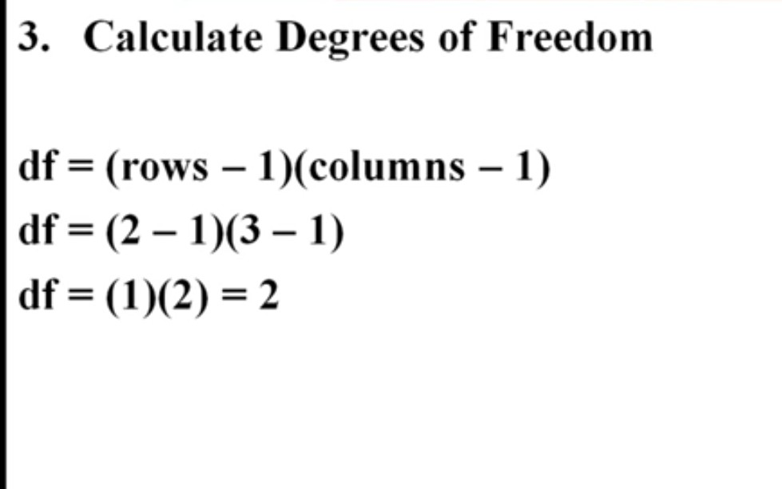

Slide 18
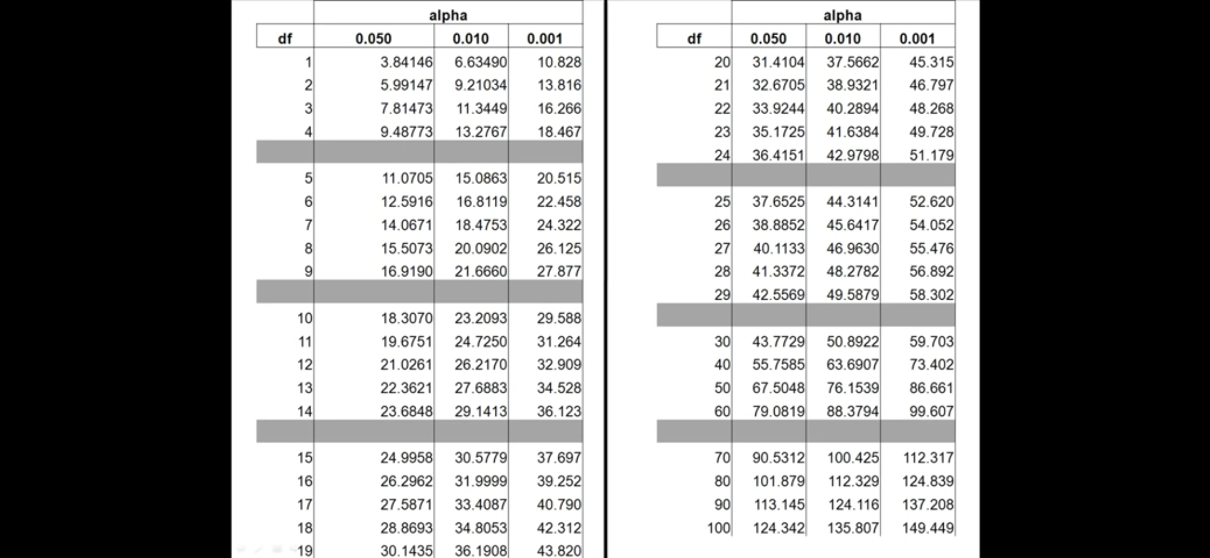

Slide 19
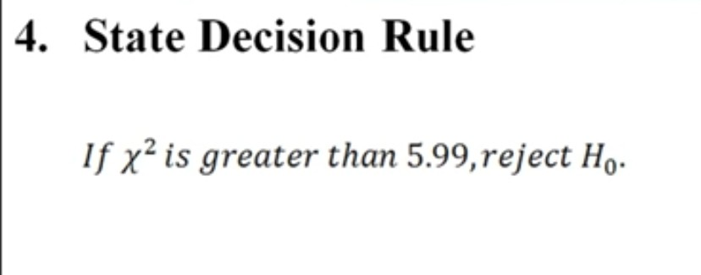

Slide 20
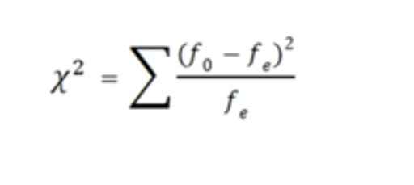
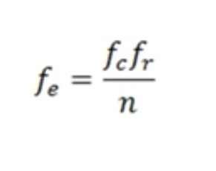

Slide 21
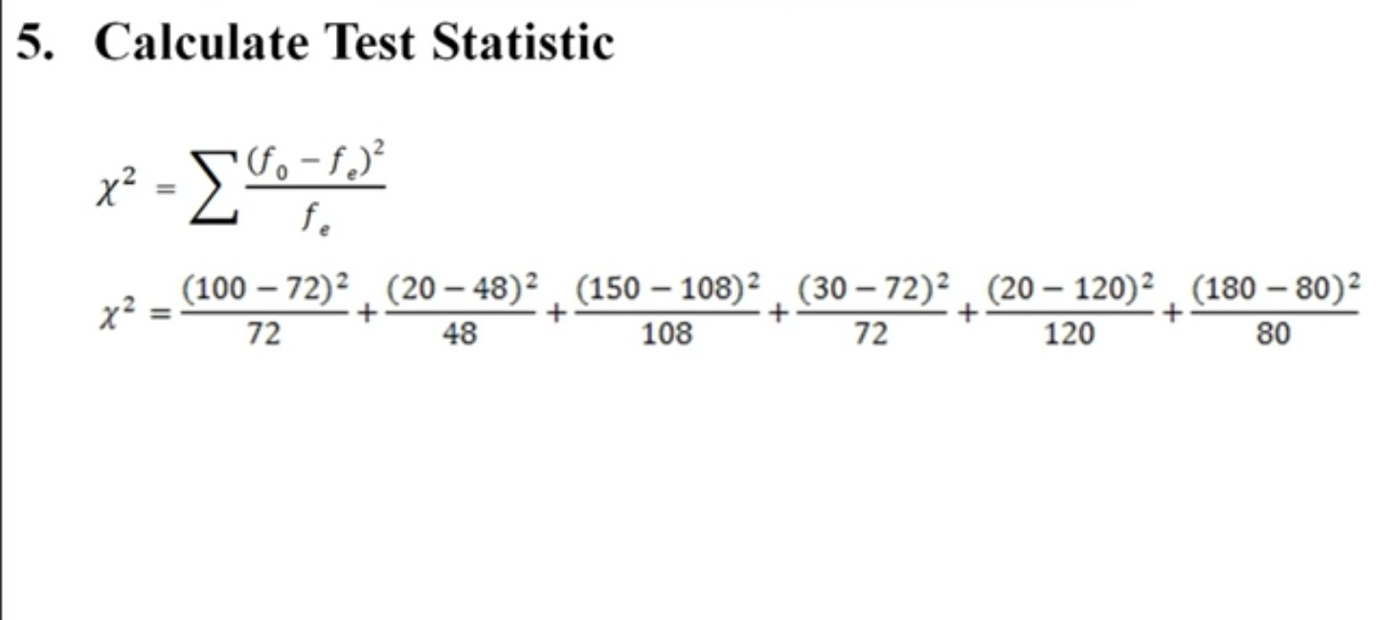

Slide 22
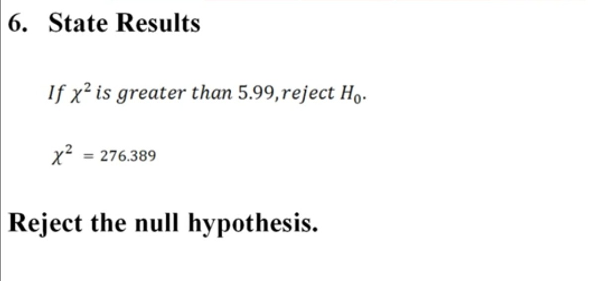

Slide 23
